Slide 1
BANK MANAGEMENT SYSTEM
Presented by,
P.Sakthivel

Slide 2
AIM OF THE PROJECT
The aim of a bank management system is to automate and streamline banking operations to ensure accuracy, efficiency, and security.
Provide tools for small businesses
A bank management system can provide small businesses with tools to manage their financial operations and improve customer satisfaction

Slide 3
BUSINESS PROBLEM OR PROBLEM STATEMENT
The business problem revolves around the need for a Bank Management System that allows for efficient management of customer accounts and transactions. The system should handle basic banking operations.

Slide 4
PROJECT DESCRIPTIONS
The Bank Management System is a software project designed to manage customer accounts and perform basic banking operations like account creation, deposits, withdrawals, balance checks, and displaying account details. This project simplifies the operations of a traditional banking system by allowing users to interact with accounts through a command-line interface (CLI).
The purpose of this project is to create an efficient system for managing bank accounts. It allows for the creation of multiple accounts, performing transactions (deposits and withdrawals), and providing users with up-to-date account information. The project is designed to simulate a basic banking environment that can be used as a prototype or educational tool.

Slide 5
FUNCTIONALITIES
__init__(self):
Purpose: Initializes the bank management system with an empty dictionary called accounts, which will store multiple BankAccount objects.
Create_account(self):
Purpose: Allows the user to create a new account by providing an account number, name, and initial balance. It ensures that the account number is unique.
deposit_to_account(self):
Purpose: Allows the user to deposit money into an existing account. The user provides an account number and deposit amount.

Slide 6
check_balance(self):
Allows the user to check the balance of a specific account by entering the account number.
display_account(self):
Displays the details of a specific account by entering the account number.
display_all_accounts(self):
Displays the details of all the accounts stored in the system. If no accounts exist, it prints a message indicating that no accounts are available.
start(self):
The main loop that runs the bank management system. It provides the user with options to create an account, deposit, withdraw, check balances, display accounts, and exit.

Slide 7
ERROR HANDLING
The system handles common errors, such as invalid inputs, insufficient funds, and duplicate account numbers, providing appropriate messages.

Slide 8
CODE IMPLEMENTATIONS
The provided code for a bank management system includes the necessary functions to,
Create accounts
Perform deposits and withdrawals
Check balance
Display account details

Slide 9
FUTURE EXTENSIONS
Authentication: Add user authentication with PINs or passwords to secure accounts.
Interest Calculation: Implement interest calculation for savings accounts.
Transaction History: Maintain a transaction log for each account to track deposits, withdrawals, and other activities.
Graphical User Interface (GUI): Develop a GUI using frameworks like Tkinter or PyQt to make the system more user-friendly.
Database Integration: Connect the system to a database (e.g., SQLite or MySQL) for persistent storage of account data.

Slide 10
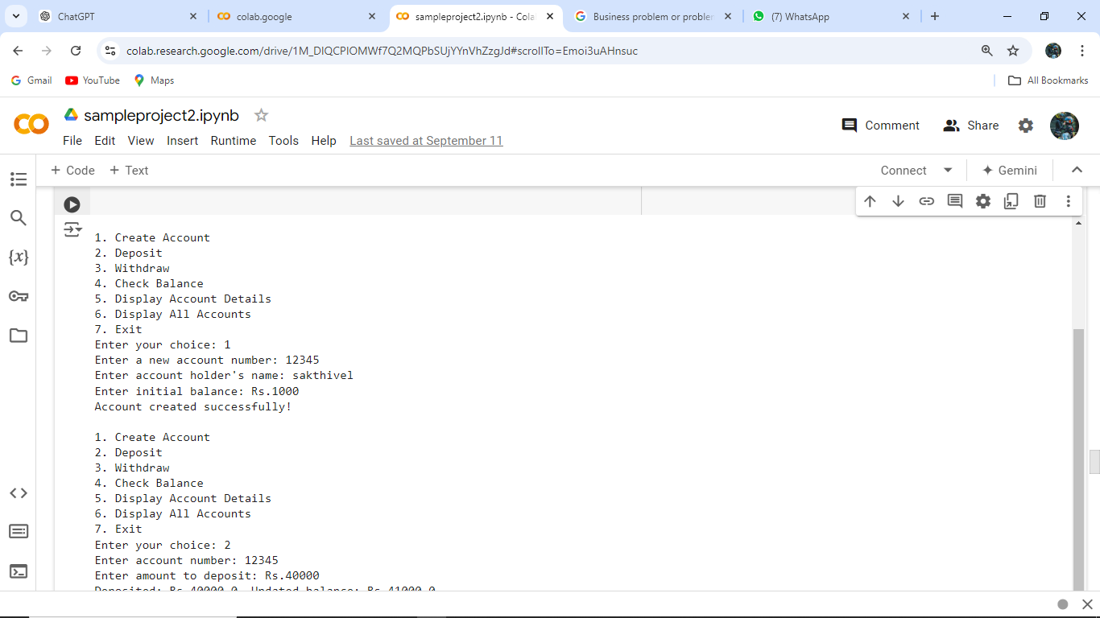
RESULT

Slide 11
CONCLUSION
The Bank Management System project provides a basic simulation of how a real-world bank operates, focusing on account management and transactional operations. This project is ideal for learning object-oriented programming concepts, file handling, and the basics of financial systems. It can be expanded into a more robust system with advanced features such as security and transaction history logging.

Slide 12

sk

